Slide 1


Zeta Phi Beta Sorority, Inc.,
Sigma Kappa Zeta Chapter
(Brooklyn, NY)
Extolling Excellence and Discouraging Satisfaction with Second Rate
Sigma Kappa Zeta Chapter History
Presenter: Soror Virna Springer
Valerie Hollingsworth Baker
International Grand Basileus
Gina Merritt Epps, Esq.
Atlantic Regional Director
Ayris B. Granby
New York State Director

Slide 2
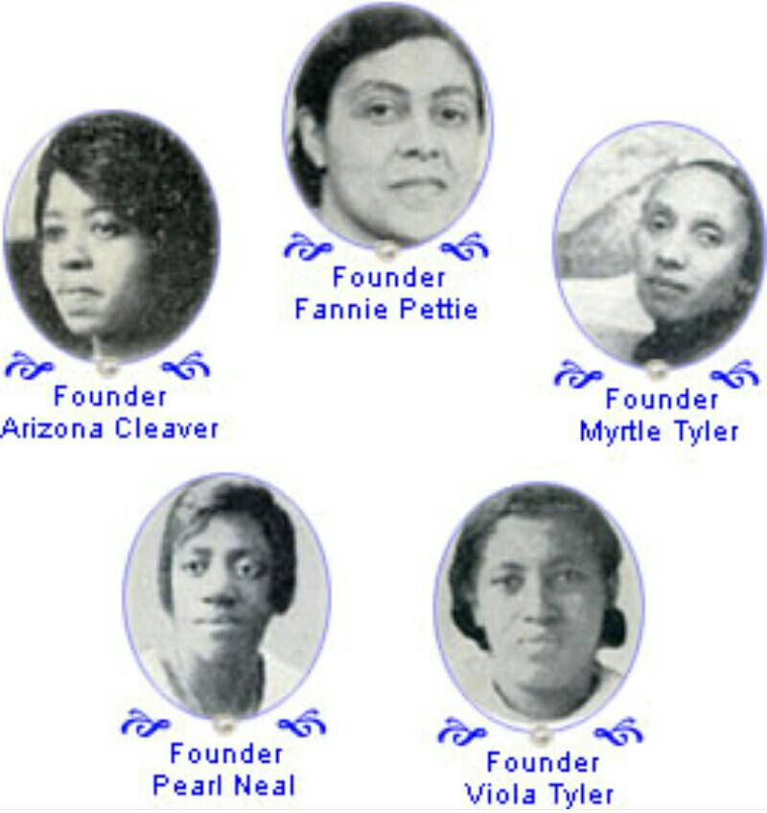
Zeta Phi Beta Sorority, Inc.
Our 5 Founder’s

Slide 3

Sigma Kappa Zeta Chapter History
Received charter approval from International Grand Basileus Dr. Barbara West Carpenter in 2001
Sigma Kappa Zeta Chapter was chartered on Friday, September 7, 2001 to serve the borough of Brooklyn, NY; however, the official celebration of the chapter chartering occurred Saturday, November 3, 2001 at Cake Man Raven.
The chartering ceremony was officiated by Past International Grand Basileus, Dr. Edith V. Francis.
Invited guests also included, Past NY State Director (2001), Soror Jacqueline Lemon Denton, Members from Delta Alpha Zeta (Brooklyn), Rho Xi Zeta (Staten Island), Delta Mu Zeta (Harlem), Rho Omicron Zeta, Iota Theta Zeta (Long Island), Kappa Epsilon Zeta (Bronx), Gamma Xi Zeta (Westchester), visiting Sorors from Ohio, Brothers of Kappa Beta Sigma (Brooklyn) and visiting brothers from Louisiana.
This presentation is the property of Zeta Phi Beta Sorority, Inc., Sigma Kappa Zeta Chapter and may
not be reproduced without our expressed consent.

Slide 4
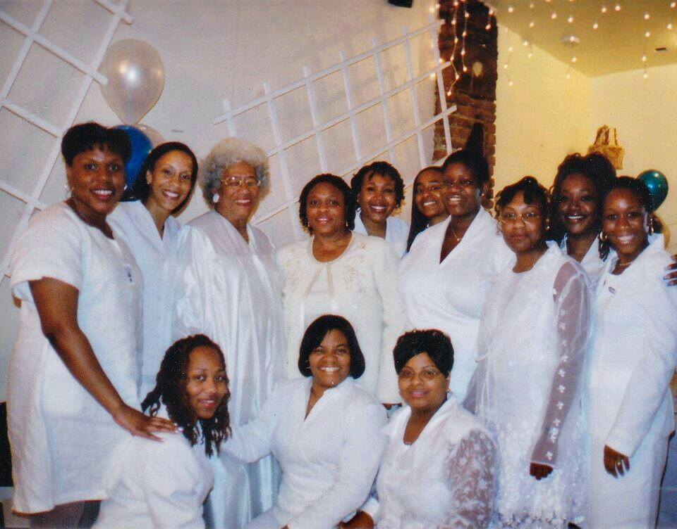
Chartering Picture

Slide 5
Sigma Kappa Zeta Chapter 1st officers
Basileus – Tara Mock
1st Anti Basileus – Karen Gooden
2nd Anti Basileus – Camille Titus
3rd Anti Basileus – Virna Springer
Phylacter – Patricia MaGlashan
Tamias – Shameka Durant
Grammateus – Tanya Denny
Tamias-Grammateus – Norita Wiggins
Antipokritis – Ericka Tate-Souvenir
Epistoleus – Tanya Wiggins
Sunshine Chair – Tanya Denny
Finer Womanhood Chair – Eudora Wallace
This presentation is the property of Zeta Phi Beta Sorority, Inc., Sigma Kappa Zeta Chapter
and may not be reproduced without our expressed consent.

Slide 6
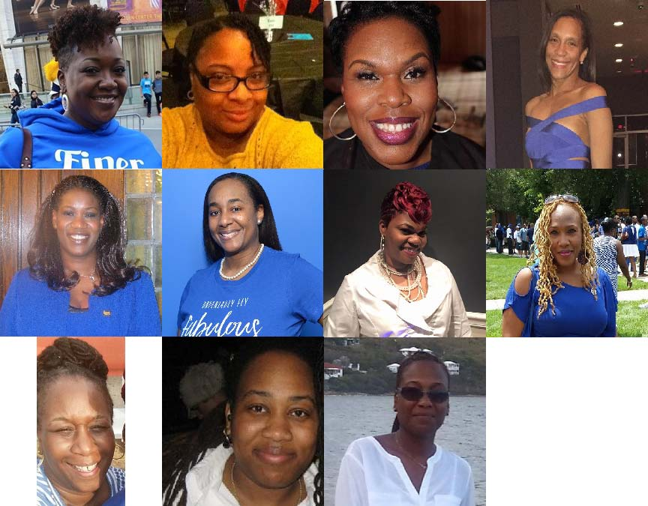
Charter Members
Tanya Denny
Shameka Durant
Karen Gooden
Tara Mock
Patricia McGlashan
Ericka Tate-Souvenir
Virna Springer
Camille Titus
Eudora Wallace
Tanya Wiggins
Norita Wiggins
This presentation is the property of Zeta Phi Beta Sorority, Inc., Sigma Kappa Zeta Chapter
and may not be reproduced without our expressed consent.

Slide 7
Our Mission
The mission of Zeta Phi Beta Sorority, Inc., Sigma Kappa Zeta Chapter, an organization of community-conscious, college-educated women, is to be actively committed to strengthening families, children, and communities through educational initiatives, peer mentoring, grass roots volunteerism, coalition building, and economic empowerment in support of girls and women.
Our Vision
Sigma Kappa Zeta will be a culturally competent chapter recognized throughout Brooklyn, New York State, and the Atlantic Region, as Zeta Phi Beta Sorority, Incorporated's preeminent chapter in service to women; as a result of its demonstrated commitment to effecting positive changes in the station of women in the Brooklyn community, its ability to obtain sufficient resources to support its efforts, enabling the provision of quality services, its commitment to the empowerment of women and children, and its vision to improve the educational and economic stations of its beneficiaries.
This presentation is the property of Zeta Phi Beta Sorority, Inc., Sigma Kappa Zeta Chapter
and may not be reproduced without our expressed consent.

Slide 8
Chapter Theme
Extolling Excellence and Discouraging Satisfaction with the Second Rate
Meetings
Sigma Kappa Zeta chapter meets the third Sunday of every month
This presentation is the property of Zeta Phi Beta Sorority, Inc., Sigma Kappa Zeta Chapter
and may not be reproduced without our expressed consent.

Slide 9
SKZ Firsts
2001-2002 Sigma Kappa Zeta Chapter Accomplishments
First Chapter Meeting held at Medgar Evers College
SKZ appointed Soror Tara Mock to serve as the first Basileus
Created the first edition of the SKZ Constitution and By Laws
First appointed NYS Officer from our chapter was Soror Virna Springer, NYS Sunshine Chair 2002-2004.
1st Community Service Projects: YWCA & Girls Talk Inc., Spr. ‘02
SKZ First Finer Womanhood chair was Soror Eudora Wallace.
SKZ First Finer Womanhood Week Celebration (February 2002)
  (Home Buyers Seminar, Foster Care Information/Parent Recruitment Session, Fellowship at Brooklyn Tabernacle with KEZ Sorors, Reclamation, and Spa Day)
First Retreat held at Soror Tanya Wiggins home, Sum.’02
  The Chapter participated in workshops focused on leadership and development as well as team building exercises designed to improve the management of the chapter affairs and forge cohesive bonds of sisterhood.
This presentation is the property of Zeta Phi Beta Sorority, Inc., Sigma Kappa Zeta Chapter
and may not be reproduced without our expressed consent.

Slide 10
2002 -2004 Sigma Kappa Zeta Chapter Accomplishments
First Elected Chapter Basileus Soror Karen Gooden
Circle of Sisterhood established
Established Co-chairs of Officers to create a smooth transition of future Leaders (Sorors Tanya Denny & Nneka Nijedeka)
Produced first edition of SKZ Happenings
Soror Jill Dingle appointed as SKZ's first Z-HOPE Coordinator
Developed and implemented Z-HOPE programs and participated in Prematurity Awareness Day
Won 2nd place in the 5-25 chapter size category in the Atlantic Region for ZHOPE activities at Boule 2004 and recognized at NYS Leadership Conference
Developed the first edition of the SKZ Modus Operandi
First Reclaimed member; Soror Roxanne Slater from Phi chapter
Established criteria and elected the first ZPB SKZ Zeta of the Year; Soror Keisha Gaillard
This presentation is the property of Zeta Phi Beta Sorority, Inc., Sigma Kappa Zeta Chapter
and may not be reproduced without our expressed consent.

Slide 11
Amicette Club
Established Amicette Club on October 26th, 2002 and the 1st advisor was Soror Virna Springer
  (Charter members include: Valencia Springer, Ashley London, Elexus Knox, Seleah Sheares, Alexis Nicholson, Karis Bamba, Sherise Clark, and Nia Bronson)
First Father/Daughter Formal Dance and Mother/Daughter Luncheon (Amicette Club) Spring 2003
Amicette Club Praise Dancers performed for SUNY Downstate Medical Center with Hezekiah Walker and the Love Fellowship Choir at the Brooklyn Museum.
1st community service project: Amicettes participated in Race to Deliver with Tyson Beckford to raise money for terminally ill home bound individuals. NOV. 2002
Established Amicette Scholarship 2003 (Soror Ericka Tate-Souvenir)
Performed for the Residents at Cobble Hill Nursing Home (Amicette Club)
Donated Toys initally NY Foundling for Deaf children. Within the past 12 years the toys were donated the Pediatric Immunology Department at SUNY Downstate Medical Center.
Elected the first Amicette Club Mother of the Year: Lenora Drakes-Sheares
This presentation is the property of Zeta Phi Beta Sorority, Inc., Sigma Kappa Zeta Chapter
and may not be reproduced without our expressed consent.

Slide 12
2004-2006 Chapter Accomplishments
Purchased Water Well in Ghana, West Africa as a part of the Z-HOPE initiative
Won first place for the most Z-HOPE Project completed in our category at Boule 2006
Held Halloween and Christmas Party at Angel Guardian Foster Care Agency (mother/baby home)
Donated School Supplies to Guyana
Raised $1000 for the March of Dimes
First SKZ informational held at South Oxford Space
2003-2006 SKZ FundRaising committee sucessfully executed combined fundraisers & community service events/collections that benefited Rose S. Kennedy mother/baby shelter and Siloam and The Open Door Churches
Shoe drive to Haiti
This presentation is the property of Zeta Phi Beta Sorority, Inc., Sigma Kappa Zeta Chapter
and may not be reproduced without our expressed consent.

Slide 13
Community Service Partnerships
Participated in NY Cares and March of Dimes Walk
Established relationship with Barnes and Nobles, Fall 2002
Established relationship with the YWCA Center for Girls, International Organization for Adolescents (IOFA) and participated/co-sponsored Girls' Talk Spring 2002
Established linkage with Rose Kennedy Family Center, Spring 2002
Zeta's Pre-maturity Awareness Sunday at Hiddekel Outreach Ministries, Fall ‘02
Established Relationship with American Diabetes and participated in Diabetes Expo, Fall 2002
Established community relationship with Siloam Presbyterian Church, the Open Door Church, Westminster Bethany Presbyterian Church, HOPE Gardens and Renaissance Women shelter. Fall 2003
Establish partnership and presented Z-HOPE Workshop at Expectant Mother's Care Agency, Spring 2004
Establish partnership and presented Z-HOPE Workshops at Girls Give Back Program of the YWCA Center for Girls’ & at the Dr. Betty Shabazz School.
This presentation is the property of Zeta Phi Beta Sorority, Inc., Sigma Kappa Zeta Chapter
and may not be reproduced without our expressed consent.

Slide 14
Signature Fund-raising Events
In February 2002, SKZ’s 1st Fundraiser was a family and friends bowling at Gil Hodges Bowling Alley.
In 2004, the Fundraising Committee recommended & moved for 3 signature events that became a part of the Chapter’s Modus Operandi
  The Family and Friends Bowling Party
  Barnes & Noble gift wrapping
  Atlantic City bus ride
In 2015 & 2017, SKZ held two fundraisers that we hope will become two of our new signature events
  Casino Royale
  Spades Tournament
This presentation is the property of Zeta Phi Beta Sorority, Inc., Sigma Kappa Zeta Chapter
and may not be reproduced without our expressed consent.

Slide 15
Additional Chapter Community Service Accomplishments
New York Care's Day at a local Elementry School
American Diabetes Walk
Donated Canned/Dry Food to benefit the sick and shut-in during the Thanksgiving holidays in conjunction with Westminster Bethany Presbyterian Church
Clothing Drive to benefit The Open Door Church of God in Christ in Bedford-Stuyvesant
Feed the Homeless on Thanksgiving Day
Christmas Toy Drive to benefit NY Foundling Hospital for the Deaf
New York Cares' Coat Drive during the month of December
Shoe Drive to Jamaica
2012, 1st SKZ Executive Board Choice awardee: Mychell Edwards
This presentation is the property of Zeta Phi Beta Sorority, Inc., Sigma Kappa Zeta Chapter
and may not be reproduced without our expressed consent.

Slide 16
Archonette Club
On September 16th, 2006, the Chapter welcomed a new addition to its Youth Auxiliary branch: The Archonette Club.
The 1st advidors were Sorors Karen Gooden & Jill Dingle
The charter members included 5 former charter Amicette Club members: Ashley London, Elexus Knox, Seleah Sheares, Valencia Springer and Sherise Clark.
The club was extended whereby the former Amicettes invited young ladies who shared their interest in the goals and ideals of scholarship, sisterly love and community service to join their club.
These additional five members were: Ashlei Alexander, Kai Greene, Akilah Holder, Diamond Mazelin, and Nitya Walker.
Archonette scholarship was established in 2007.
Archonettes are no strangers to community service. Their 1st year of service consisted with: breast cancer walk, God’s Love We Deliver, TOY Drive to SUNY Down State Hospital, Henry St. nursing home & MOB
This presentation is the property of Zeta Phi Beta Sorority, Inc., Sigma Kappa Zeta Chapter
and may not be reproduced without our expressed consent.

Slide 17
Pearlette Club
On September 18th, 2010, SKZ Opened their arms to our Nationally youngest youth group.
The 1st Pearlette advisors were Sorors Virna Springer and Grace Amao
Pearlettes immediately became actively engaged with community service and as to date continue to embrace service to others. 2017 Autism Speaks walk was introduced to the club CS’s.
There were 14 girls in the inaugural club:
Jasira Brewster | Amiya Jordan
Kayla Bryant | Shatia McElroy
Karis Campbell | Madison Pascal
Jada Grey Duggins | Leah Springer
Tianna Gray | Daziah Rowe
Kiara Henry | Rihana Schulters
Jordan Jenkins | Taylor Washington
This presentation is the property of Zeta Phi Beta Sorority, Inc., Sigma Kappa Zeta Chapter and may not be reproduced without our expressed consent.

Slide 18
Sigma Kappa Zeta Initiates
Spring 2007. * Spring 2018
Kendra Wilson Sharon Carter
De’Tisha Grant Shakema Cyrus
Spring 2008 Barbara DeLalu
Grace Amao Jovana Gilkes
Simone Alleyne Monique Henry
Spring 2012 Keisha Lewars
Medgine Bernadotte Ginette Peterson
Spring 2016. Trina Rivers
Shaquana Montgomery-Humphrey. Letrice Walker
Mianna Questelles
Desiree Whitehead
Nadia Wright
This presentation is the property of Zeta Phi Beta Sorority, Inc., Sigma Kappa Zeta Chapter
and may not be reproduced without our expressed consent.

Slide 19
EEFSS
The Extolling Excellence Foundation for Service and Scholarship, Inc.,(EEFSS), a philanthropic arm of Zeta Phi Beta Sorority, Inc., Sigma Kappa Zeta Chapter (Brooklyn, NY). The Foundation was established in 2008 to award scholarship grants to worthy young NYC women who are completing their senior year of high school or entering a four year accredited college or university.
The goals of the EEFSS, Inc is to assist in their pursuit of higher education, conduct community programs which will aid in the improving in individual and community living standards; engage in activities which will aid in the educational development of all women; and in any appropriate research related to the purposes of the Foundation.

Slide 20
On September 5, 2011 the Foundation announced the launch of its Extolling Excellence Scholarship. The scholarship is created largely through grassroots fundraising efforts. The scholarship is awarded based on the merits of the student’s GPA, community service and extra-curricular activities, as well as a competitive written essay.
On December 10, 2011, in celebration of Sigma Kappa Zeta’s 10th anniversary, the Chapter awarded a $10,000 scholarship to Ms. Sumaira Mian, a deserving young woman who exemplified the ideals of our founding principles by achieving the highest standards in academic and community service.
In 2016 the Foundation was granted 501c3 tax exempt status by the IRS. In 2018 the Foundation was granted New York Sales Tax Exempt status by the IRS.
The current Board Members are:
Beverly S. Tatham, Esq - Chair
DeTisha Grant - Vice President
Camille Titus - Secretary
Kendra Wilson - Treasurer
Keisha Alleyne - Legal Counsel

Slide 21
SKZ Youth doing STEM
SKZ Amicette and Archonette clubs participated with their 1st Naval Seaperch STEM program Spring 2013. They received honorable mention for being the only all girls group.
As to date our youth clubs were and still are the only girls clubs that actively compete in this all male dominating program.
Our Pearlette Club has been actively conducting STEM Science fairs within the last 6 years under the guidance of Soror Juliet Duggins.
Our Amicettes in 2017 embarked on a NEW STEM program: “Goals for Girls” at the Intredpid and a “Science Sleepover” at NY Hall of Science.
This presentation is the property of Zeta Phi Beta Sorority, Inc., Sigma Kappa Zeta Chapter
and may not be reproduced without our expressed consent.

Slide 22
2011 – SKZ’s 10th Anniversary
Awarded its 1st $10,000 scholarship at the chapter’s 10 year anniversary gala in December 2011
This presentation is the property of Zeta Phi Beta Sorority, Inc., Sigma Kappa Zeta Chapter
and may not be reproduced without our expressed consent.

Slide 23
Girls to Pearls
Camille Bailey Spr. ’14 St. John’s University. Former SKZ Amicette and Archonette
Shaniyah Hydman Fall ’14 Fairleigh Dickinson University. Former SKZ Amicette and Archonette
Seleah Sheares Spr. ’15 University of Maryland at Eastern Shore. Former SKZ Amicette and Archonette
Mianna Questelles Spr. ’16 Grad Chapter. Former SKZ Amicette and Archonette
Valencia Springer Spr. ’16 Virginia Union University. Former SKZ Amicette and Archonette
Rebekah Schulters Spr. ’17 North Carolina A&T University. Former SKZ Amicette and Archonette
Kassia Pierre-Louis Spr. ’18 Hampton University. Former SKZ Archonette
Makayla Anderson Spr. ’18 Hampton University. Former SKZ Archonette
Kaylyn Alston Spr. ‘18 Montclair State University. Former SKZ Amicette
Shanyah Mitchell Fall’20 Cornelle University. Former SKZ Amicette and Archonette
Lauren Linton Fall ’20 SUNY Old Westbury. Former SKZ Amicette and Archonette
Arielle Mclean Spr. ‘21 Spelman College . Former SKZ Archonette

Slide 24
SKZ Past Chapter Basileus
2001-2002: Tara Mock (appointed)
2002-2004: Karen Gooden
2004-2006: Keisha Alleyne
2006-2007: Beverly Tatham
2007-2008: Camille Titus
2008-2009: Lisa Francis
2009-2010: Robin Annunziata (Acting)
2010-2011: Kendra Wilson (Acting)
2011-2013: Karen Gooden
2013-2015: Keisha Alleyne
2015-2016: Rana Constance
2016-2018: Shavonne Ceruti-Gay
2018-2020: Andrea Wright
This presentation is the property of Zeta Phi Beta Sorority, Inc., Sigma Kappa Zeta Chapter
and may not be reproduced without our expressed consent.

Slide 25
Sigma Kappa Zeta
Chapter History
Created Spr.’ 2016 by Soror Sabrina Dukes
Revised Summer 2016 by Soror Virna Springer
This presentation is the property of Zeta Phi Beta Sorority, Inc., Sigma Kappa Zeta Chapter and may not be reproduced without our expressed consent. If you like the presentation, respect our intellectual property and contact us at
sigmakappazeta@onebox.com

